Slide 1

D&D Optimal Combat Encounter
Alyssa Vellucci, Jonas Wagner
MECH 6326: Optimal Control & Dynamic Programming
Spring 2023
Notes:
Save this document with a new name before you begin work.
When adding a new slide, click on the small arrow next to “New Slide” on the toolbar. Select the layout that will best fit the content you want to add.
Change the layout of an existing slide: click the “Layout” button on the top toolbar to reformat your existing content to another master slide.
Refer to utdallas.edu/brand for specific rules on using the University logos and wordmarks.

Slide 2
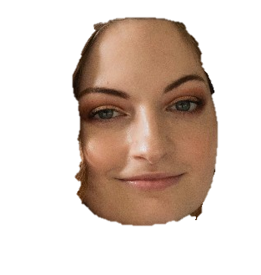




D&D Optimal Combat Encounter
Introduction
Problem & Model Formulation
Dynamic Programming
Numerical Experiments
Conclusions
DYNAMIC PROGRAMS
Notes:
alyssa

Slide 3
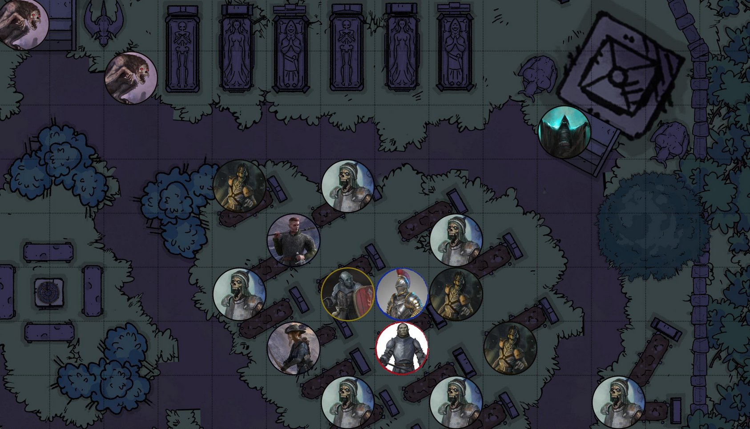
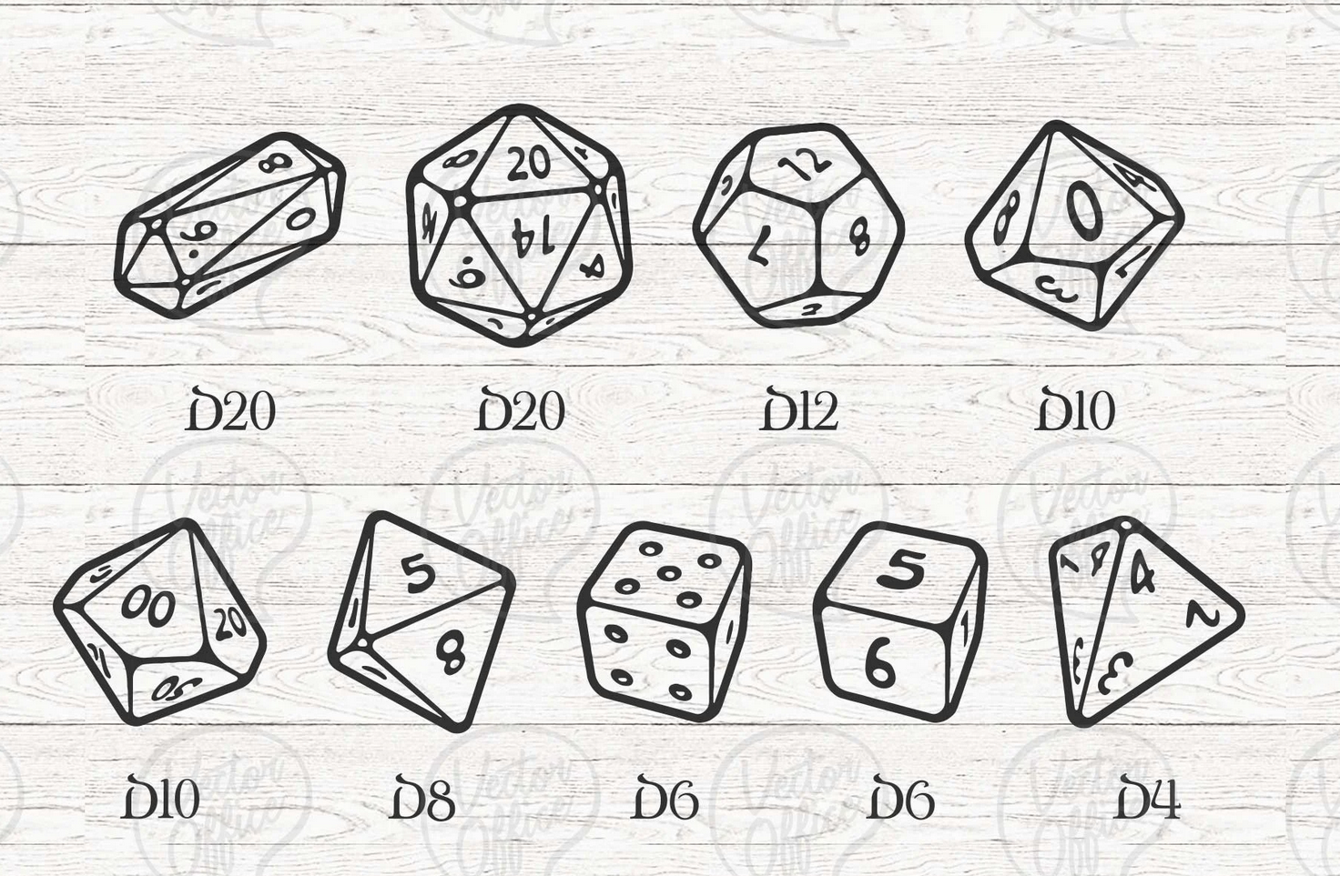
Introduction
D&D Optimal Combat Encounter
Dungeons & Dragons (D&D) is a tabletop roleplaying game.
Combat encounters consist of an enemy (monster) and player characters (PCs). The PCs want to defeat the monster and remain alive themselves. The success of their actions is determined by a dice roll.
General process for a combat encounter:
Player moves their PC on the battle-map
Player chooses an action to perform (weapon attack, health potion, etc.)
Player rolls required dice to determine the outcome of that action
Motivation: Given a dynamic combat scenario, what are the optimal actions to take to ensure that you don’t kill your character?
https://www.reddit.com/r/DungeonsAndDragons/comments/nozopn/free_vtt_token_generator_and_battle_maps_for_your/
https://www.etsy.com/listing/813121763/bundle-dnd-dice-svg-dungeons-and-dragons
Notes:
alyssa

Slide 4
D&D Combat → Problem Constraints
D&D Optimal Combat Encounter
D&D 5e Combat Rules | D&D Combat for Dynamic Programming
PCs can move at any point in their turn | PC moves at the start of their turn
PCs can move an amount equal to their “movement speed” per turn | PC moves one grid block per turn
PCs get a “bonus action” to allow them to cast spells, use class features, etc. | PC only gets one action (melee or ranged attack) and no bonus action
“Natural 20” is a critical strike + automatic hit, and a “Natural 1” is a critical fail + automatic miss | Natural 20 and Natural 1 rolls count as a regular success/fail
PC can interact with the environment (set traps, tie ropes, etc.) | Environment is flat, boundless, and has no objects to interact with
Footer information
Notes:
alyssa

Slide 5
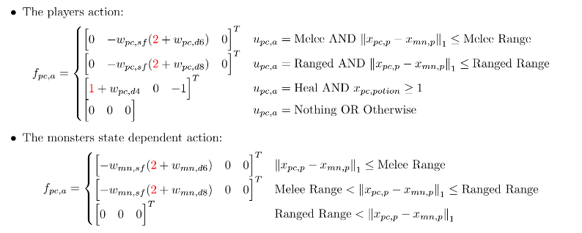
Problem Formulation (add more math?)
D&D Optimal Combat Encounter
D&D Combat for DP Ruleset:
1 monster, 1 player character
Same weapon dice, health, and movement
Movement:
PC will move at the start of its turn, then perform an action
Monster will always move toward the player
Movement includes up, down, left, right
Combat:
PC and monster can perform one melee or ranged attack per turn
PC can perform one heal action, monster cannot heal
PC and monster can choose to do nothing on their turn
No ability modifiers for PC or monster
Dice roll +0 for melee and ranged attacks
Attack ranges:
Melee: 1 block
Ranged: 2 blocks
Footer information
Notes:
jonas

Slide 6
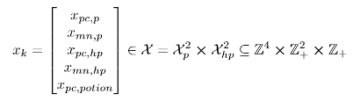
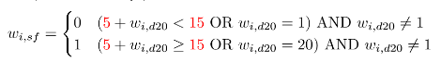
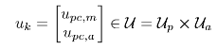
Model Formulation or maybe more math here
D&D Optimal Combat Encounter
The states of the system include:
Current position of PC
Current position of monster
Current HP of PC
Current HP of monster
Potion availability (PC only)
The inputs to the system include:
PC Direction of movement
PC Melee attack
PC Ranged attack
PC heal
Nothing
The dice used are d4, d6, d8, and d20 dice. These create the stochastic disturbance in the system. The success or failure of the input is defined as:
The monster’s inputs are state-dependent in that it will always try to move toward the PC. It will always use a melee attack if it’s close enough, and a ranged attack if it’s further away.
Notes:
jonas

Slide 7
Dynamic Programming Process
D&D Optimal Combat Encounter
1. Define Markov Chains from given problem parameters
2. Update the Markov probability matrices for each input at each location in the grid
3. Simulate the system with an “infinite” time horizon and update the system at every time step
Math? Maybe talk about the complexity of increasing HP values, movement directions, etc.
Notes:
jonas

Slide 8
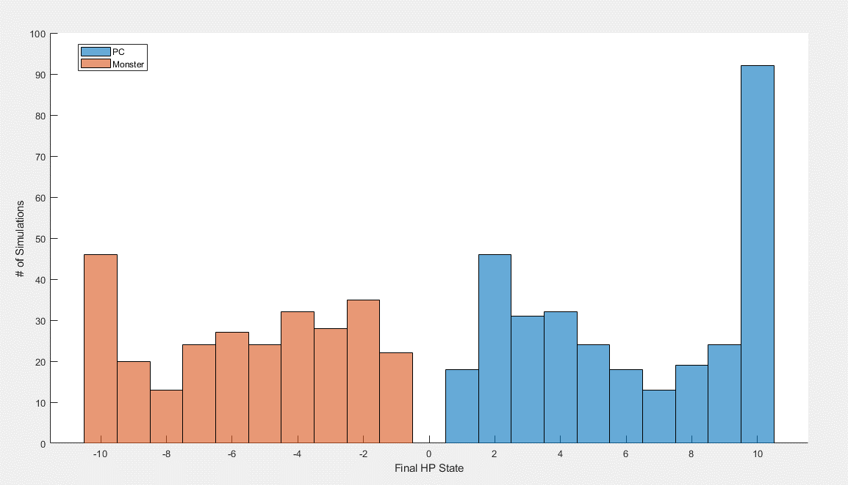
Monte Carlo Simulation
D&D Optimal Combat Encounter
Text here explaining good things about the fun chart
Notes:
alyssa

Slide 9
Comparison: Human vs. Dynamic Program
D&D Optimal Combat Encounter
Footer information
Notes:
alyssa

